Slide 1

Leveraging Consumer Data for Retail Growth
A strategic analysis to understand customer shopping behavior, improve sales, and enhance long-term loyalty.

Slide 2
The Business Challenge
A leading retail company seeks to understand shifting customer purchasing patterns across demographics, product categories, and sales channels (online vs. offline).
Changing Patterns
Key Drivers
Repeat Purchases
Noticed shifts in purchasing behavior across various customer segments and channels.
Need to uncover factors like discounts, reviews, seasons, and payment preferences that drive consumer decisions.
Focus on identifying what encourages customers to make repeat purchases and build loyalty.

Slide 3

Overarching Business Question
Optimize Strategy with Data
"How can the company leverage consumer shopping data to identify trends, improve customer engagement, and optimize marketing and product strategies?"

Slide 4

Project Deliverables Overview
Our analysis is structured around five key deliverables, ensuring a comprehensive and actionable outcome.
Data Preparation & Modeling
Data Analysis (SQL)
Visualization & Insights
Clean and transform the raw dataset using Python for robust analysis.
Organize data, simulate transactions, and run queries to extract insights on customer segments and purchase drivers.
Build an interactive Power BI dashboard to highlight key patterns for data-driven decisions.
Report and Presentation
GitHub Repository
Summarize key findings, business recommendations, and visually communicate insights to stakeholders.
Provide all Python scripts, SQL queries, and dashboard files in a structured repository.

Slide 5

Phase 1: Data Preparation & Modeling
The initial phase focuses on ensuring data quality and readiness for subsequent analysis. We use Python for cleaning and transformation.
Clean and standardize raw customer shopping data.
Engineer features relevant to purchasing behavior (e.g., frequency, recency).
Prepare the dataset structure for SQL ingestion and modeling.

Slide 6

Phase 2: Data Analysis with SQL
SQL is essential for structuring the data and extracting core business metrics related to customer behavior.
Structured Data
Transaction Simulation
Insight Extraction
Organize raw data into a relational format for efficient querying.
Model business transactions to accurately reflect real-world purchasing scenarios.
Run complex queries to analyze customer segments, loyalty metrics, and purchase drivers.

Slide 7
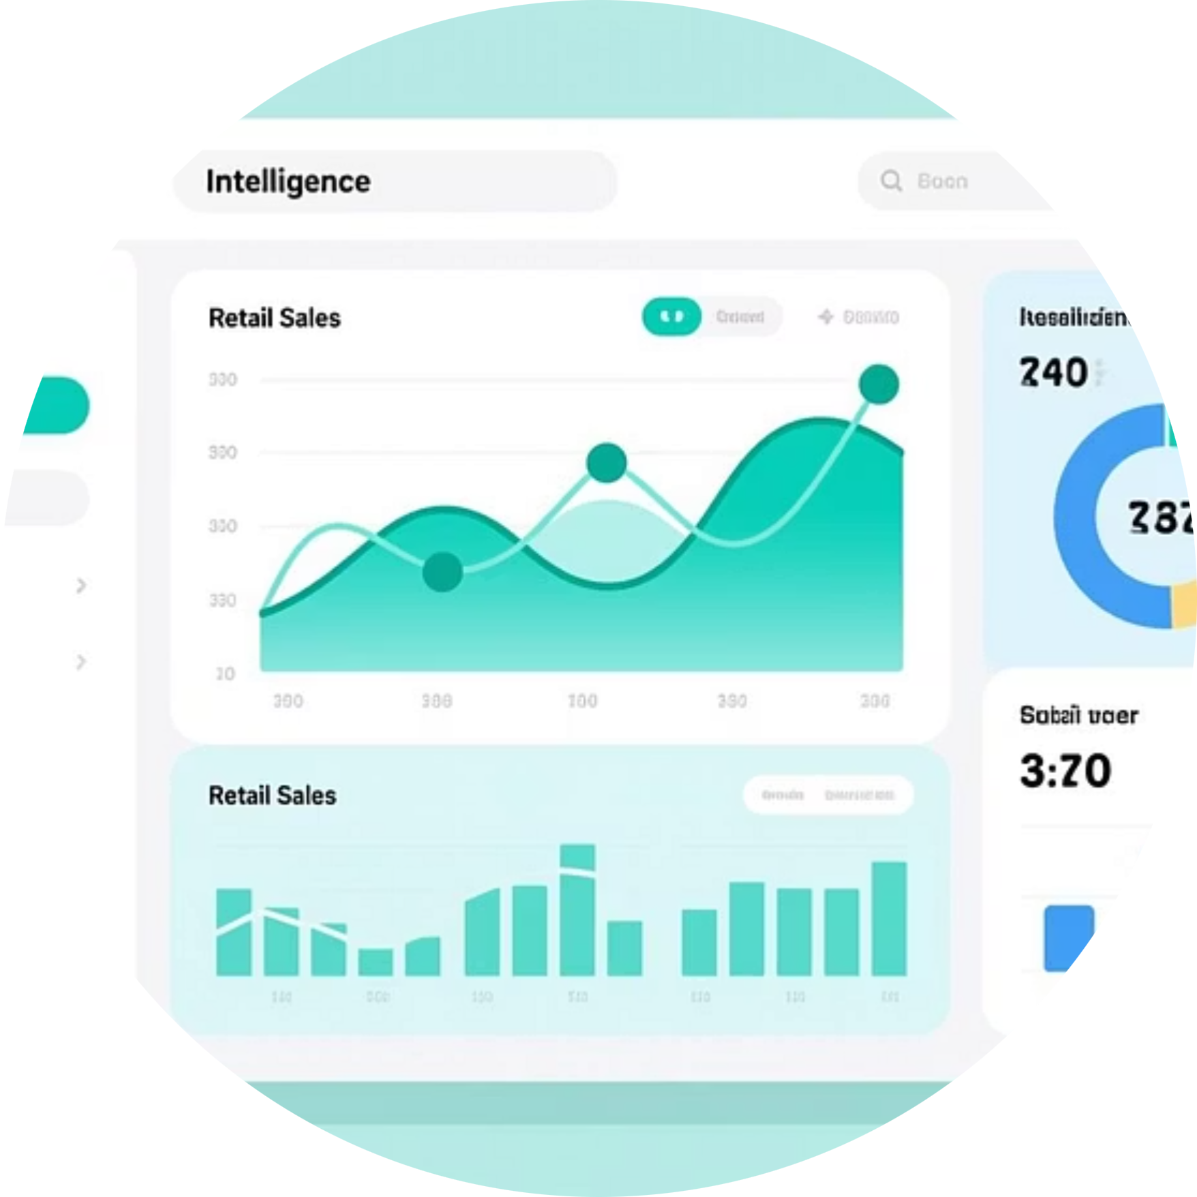

Phase 3: Visualization & Insights (Power BI)
Translating data into visual stories is crucial for stakeholder understanding and decision-making.
Interactive Dashboard
Data-Driven Decisions
Build a dynamic Power BI tool for exploring key patterns and trends.
Enable stakeholders to filter, drill down, and make informed strategic choices.

Slide 8






Key Factors Driving Consumer Decisions
We will investigate the impact of various external and internal factors on customer purchases and loyalty.
Discounts & Promotions
Product Reviews
Demographics
Seasonal Trends
Channel Preference
Payment Preferences

Slide 9


Phase 4: Reporting and Recommendations
A clear, concise report and presentation are necessary to translate technical findings into actionable business strategy.
Project Report
A written summary detailing methodology, key findings, and business recommendations.
Stakeholder Presentation
Visual communication of insights and actionable steps for marketing and product teams.

Slide 10
Project Conclusion: Actionable Insights
The ultimate goal is to provide the company with the tools and knowledge to improve customer engagement and optimize strategies based on data-driven trends.
Optimize Marketing
Refine Product Strategy
Boost Loyalty
Target campaigns based on identified segment behaviors.
Align inventory and offerings with purchase drivers.
Implement strategies to encourage repeat purchases and satisfaction.
Ready to transform consumer data into retail growth.

